Slide 1


TrustMark: Universal Watermarking for Arbitrary Resolution Images
Summary of the research paper by Tu Bui, Shruti Agarwal, and John Collomosse
Prepared by: [Your Name]
by Aravapalli Kumar

Slide 2

Core Contributions
Novel Architecture: Frequency-aware GAN model designed for imperceptible yet robust watermark embedding.
Resolution Scaling: Generalizes watermarking to images of arbitrary sizes using a residual mapping approach.
TrustMark-RM: Enables effective watermark removal and re-watermarking, supporting workflow flexibility.
State-of-the-Art Performance: Demonstrates best in class results in terms of image quality preservation and watermark robustness.

Slide 3
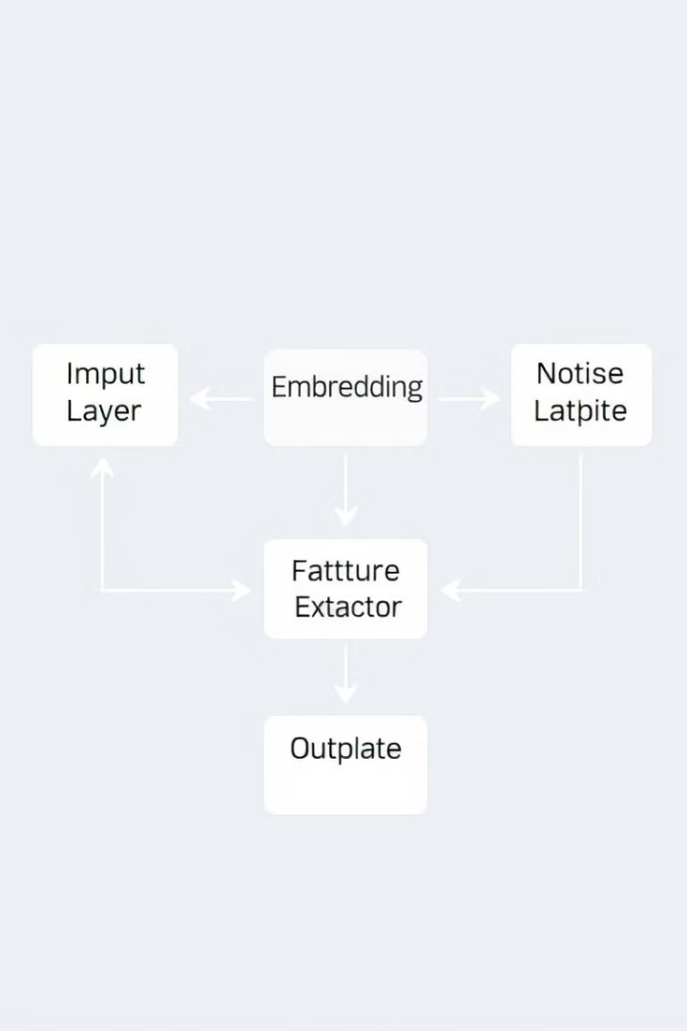
Watermarking Network Architecture
The TrustMark system consists of three integrated modules. The Embedder (E) merges watermark data into image features seamlessly, preserving image fidelity. The Noise Module (N) simulates real-world image transformations, enhancing model robustness. Finally, the Extractor (X) retrieves the watermark bits from modified or perturbed images, ensuring effective watermark recovery despite distortions.

Slide 4
Embedder Module
The embedder module accepts an input image x (256×256×3) and a binary watermark vector w. Its architecture is based on the MUNIT framework but deeper and omits normalization layers to maintain fidelity. The output y = E(x, w) is a visually identical watermarked image that hides the watermark imperceptibly within image features. This approach balances watermark invisibility with robustness against distortions.

Slide 5
Extractor & Noise Module
The extractor employs a ResNet50 backbone followed by a sigmoid to predict watermark bits from transformed images. The noise module applies differentiable augmentations simulating real-world distortions to watermarked images. Geometric modifications include cropping, resizing, and flipping, while photometric changes cover JPEG compression, blur, color shifts, and noise addition. This enables the extractor to learn to recover watermark bits reliably under various degradation scenarios.

Slide 6

Loss Functions
The training optimizes a total loss function combining quality and recovery losses: 𝓛_total = α·𝓛_quality + 𝓛_recovery. Quality loss includes multiple components—YUV color space fidelity, perceptual similarity (LPIPS), frequency domain imperceptibility (FFL), and adversarial GAN loss encouraging natural image appearance. Recovery loss enforces accurate watermark bit prediction. This multi-faceted loss ensures the watermarked images remain visually intact while embedding recoverable watermarks robustly.

Slide 7
TrustMark-RM: Removal Network
The watermark removal network, TrustMark-RM, is built on the KBNet architecture featuring attention and denoising modules to cleanly remove watermarks. Its training losses include decoder consistency loss that aims to fool the extractor network, mean squared error to minimize pixel difference between original and cleaned images, and adversarial loss to maintain realistic textures after removal. This framework supports subsequent re-watermarking workflows.

Slide 8
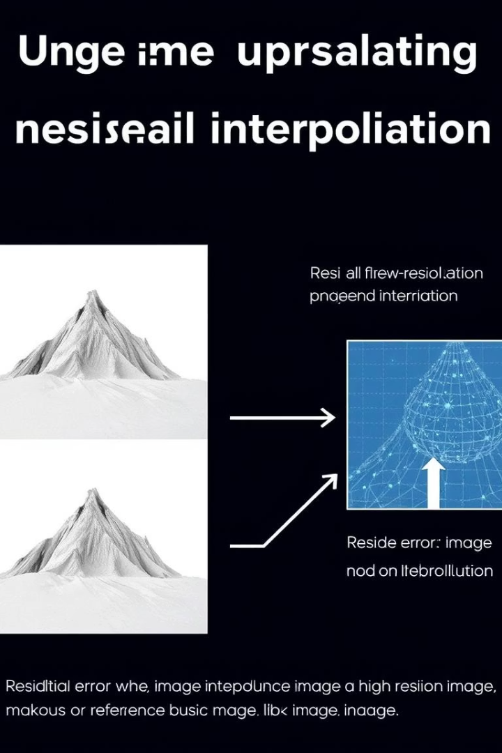
Resolution Scaling
Though trained on fixed 256×256 inputs, TrustMark supports arbitrary resolution watermarking at inference time using residual-based scaling. The method interpolates the residual difference between embedded and original downscaled image applied to the original resolution input: y = clamp(x + interpolate(E(x̄, w) - x̄), -1, 1). This technique preserves watermark quality across different image sizes without re-training, making it practical for diverse real-world applications.

Slide 9
Results Summary
TrustMark was extensively evaluated on datasets including CLIC, DIV2K, and MetFace. Key metrics such as PSNR, SSIM, and bit accuracy show consistent outperformance against baseline methods. It demonstrates resilience to JPEG compression, additive noise, resizing, and adversarial attacks like I-FGSM. Additionally, TrustMark-RM proves effective in removing and enabling reapplication of watermarks, maintaining system versatility and security assurance.

Slide 10
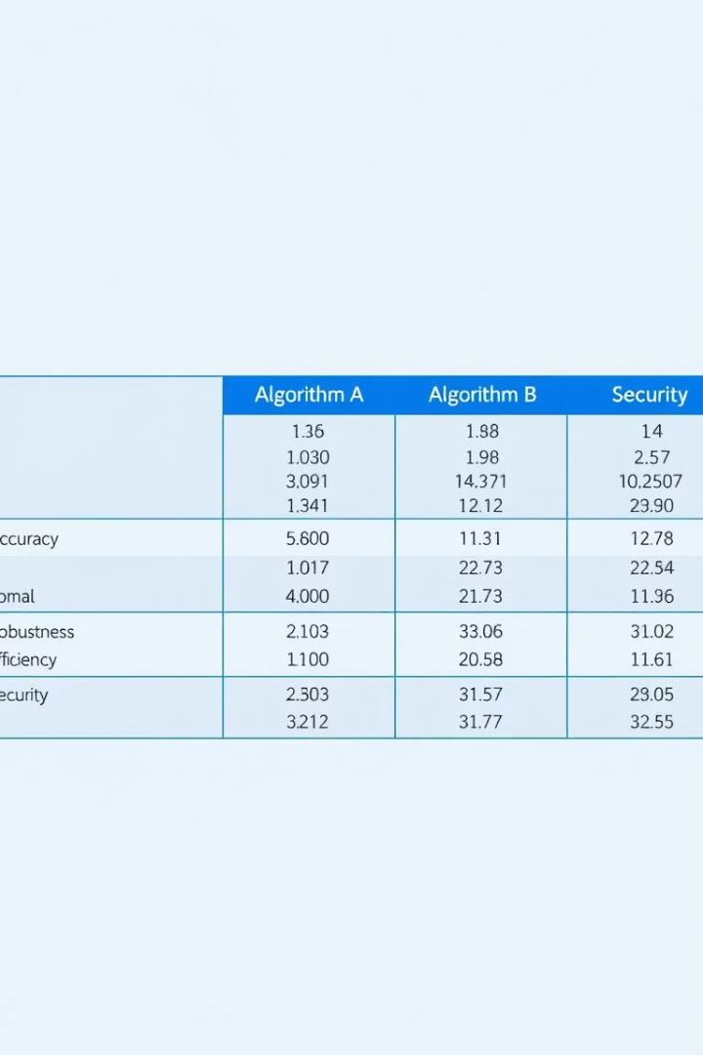
Performance Table
The following table summarizes benchmark performance metrics comparing TrustMark against existing watermarking and removal methods across multiple distortions and datasets. Metrics include Peak Signal-to-Noise Ratio (PSNR), Structural Similarity Index (SSIM), and watermark bit recovery accuracy.

